Slide 1


EMPLOYEE ATTRITION ANALYSIS REPORT
www.greendestinations.org

Slide 2
About: Green Destination
Green Destinations is a global organization created in the Netherlands to support sustainable destinations, their businesses and their communities.
Green Destinations’ core programs, the GD Awards and Certification Program for destinations, the Good Travel Program for businesses and the Top 100 Sustainability Stories are the main pillars of a country-wide stewardship approach that we have developed and piloted in Slovenia, Estonia, Australia, Brazil and Guyana.
Green Destinations developed a support program including over 40 assessment and reporting tools, including training courses.

Slide 3



Why Attrition Matters?
REPLACEMENT COST
Direct Exit Cost Recruiting Training
EMPLOYEE MORALE
Lost of Productivity Disengagement Domino Effect
KNOWLEDGE LOST
Institutional Knowledge External Relationships Service Quality
“For someone making $40K a year, replacement cost is $20K - $30K in recruiting and training expenses.”
-- Society of Human Resource Management

Slide 4

Causes of Attrition
Unsatisfying compensation and benefits
Lack of development opportunity
Lack of work-life balance
Lack of recognition
Poor management
Poor work conditions

Slide 5
Descriptive Analysis

Slide 6
Overview of Data
Green Destinations Employee
Dataset Provider: Unified Mentor
Structure
Label - Attrition
Data Types
Numeric Categorical Ordinal/Scale
1470 observations
35 attributes
“Yes”: 237 (16%)
“No”: 1233 (84%)

Slide 7

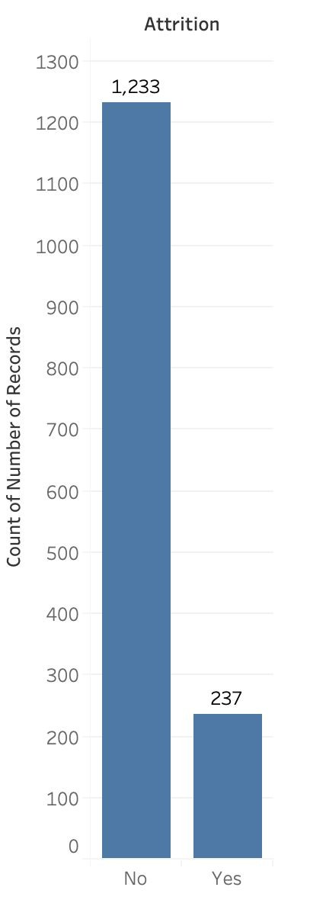
Challenges
Biased Dataset
The numbers of “Yes” and “No” are unbalanced
237 Yes
1233 No
Accuracy vs. Precision
Need to focus on the number of ‘Yes’, instead of ‘No’
TP/(TP+FP)
Too Many Attributes
Problem with overﬁtting and redundancy
35
attributes

Slide 8
Data Preprocessing

Slide 9
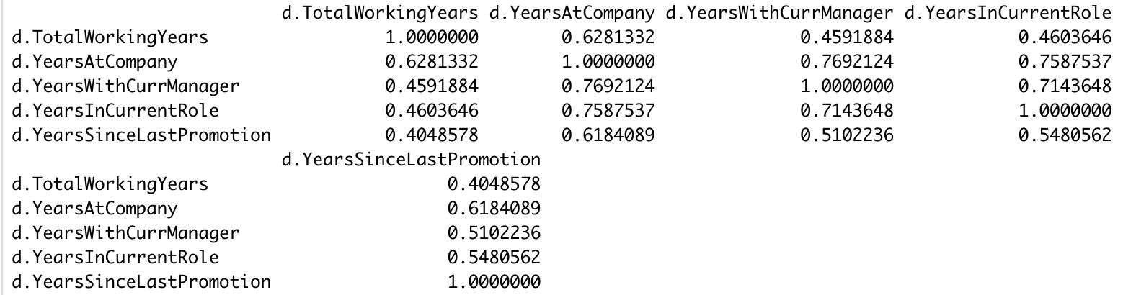
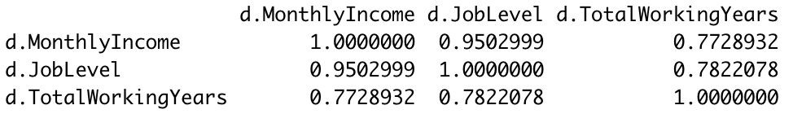
Remove Single Unique Value
Remove Highly Correlated Variables
Employee ID Employee Count Over 18 Standard Hours

Slide 10
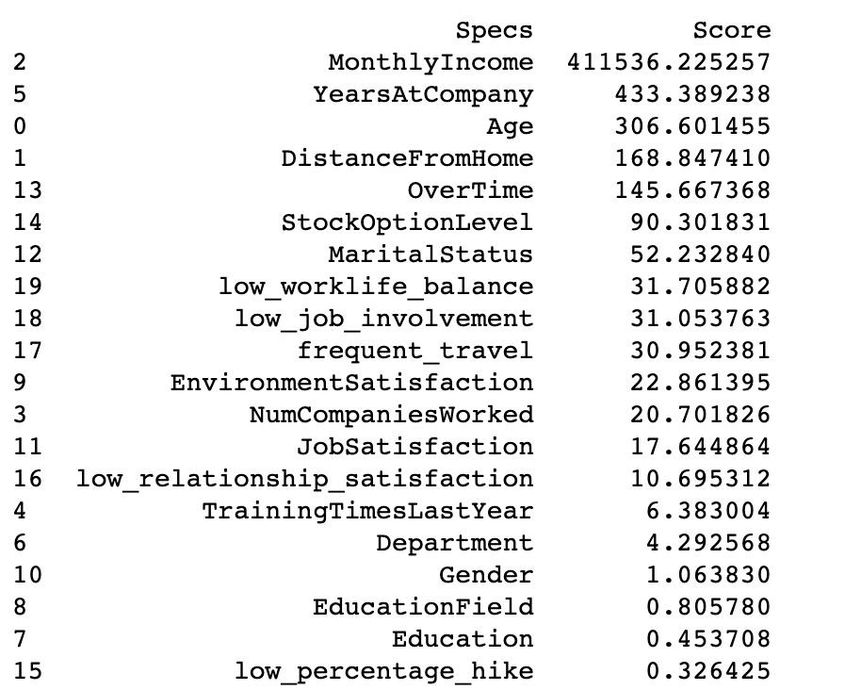
Feature Selection
Top Features:
Monthly Income
Over Time
Stock Option Level
Years At Company
Age
Distance From Home
Whole dataset

Slide 11
Insights & Recommendation

Slide 12
Attributes inﬂuences Employees to Leave
Overtime
Time/effort
Monthly Salary
Satisfactory Pay
Job Involvement
Development
Age
Development
Stock Options
Satisfactory Pay
Years With Company
Working Conditions

Slide 13
Characteristics of Attrition by Department
Insight 1
Insight 2
Insight 3
Employees with Life Sciences Degrees are more likely to leave when working for Research and Development Department.
Employees from all departments are roughly twice as likely to leave when working overtime.
Employees tends to leave the most after completing First Year at company.
85%
2X
37%

Slide 14
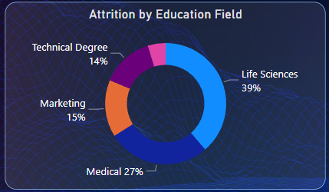
Attrition by Education Field
Features:
Life Sciences - 39%
Medical - 27%
Marketing – 15%
Technical Degree – 14%
Others – 5%

Slide 15
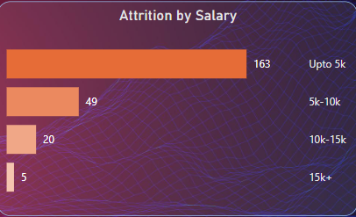
Attrition by Salary
Feature:
Most of the employee from each department leaving the company due to low salary.

Slide 16
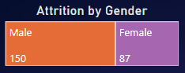
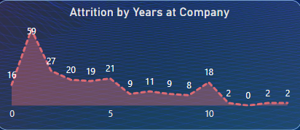
Attrition by Year at Company
Feature:
Male and Female ratio is 150:86
Employee decides to leave company after completing 1 year, 5 years and 10 years.
Attrition at first year is maximum, employee go for go for the better opportunity or salary after gaining some experience.

Slide 17
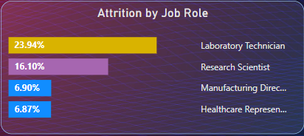
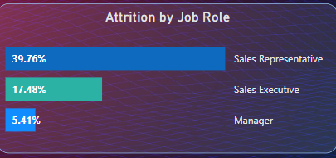
Attrition Rate in Different Departments
Research & Development:
Laboratory Technician shows 23.94% of attrition rate followed by Research Scientist at 16.10%
Sales:
Sales Representative shows 39.76% of attrition rate followed by Sales Executive at 17.48%

Slide 18

THANKS
Submitted By:
Nikhil Ranghera

